Slide 1
# Phase-3-Project-Machine-Learning Analysis of Churn in Telecom's dataset Phase 3 Project Eliud Kibet

Slide 2
Agenda
Overview
Business and Data Understanding
Modeling
Evaluation
Recommendations
Next Steps

Slide 3
Introduction

Slide 4
Overview
This project analyzes customer data from a select Telecom company to predict which customers are likely to leave the company (churn).
Data source: https://www.kaggle.com/datasets/becksddf/churn-in-telecoms-dataset?resource=download
Project objective
This project will help the company identify customers at risk of leaving and take action to keep them

Slide 5
Business and Data Understanding
Telecom companies lose revenue whenever their customers cancel service and this project will this help the stakeholders to undertake the following three aspects:
a) Understand why customers leave
b) Predict which customers will leave
c) Find ways to reduce customer loss
Data
The dataset contains information about 3,333 customers where each row represents one customer
Key columns include:
- `state`, `area code`, `phone number`, `account length`, `international plan`, `voice mail plan`, `customer service calls` and `churn`

Slide 6

Methodology and output

Slide 7
Methodology
1. Exploratory Data Analysis (EDA) to Understand patterns in the data
2. There was no data cleaning done since there were no missing values. However at the point of model creation we dropped some columns to retain the most relevant features.
4. Modeling: tried two different machine learning models (a- Logistic regression and 2) Decision Tree to predict churn
5. Evaluation: Used metrics like Accuracy, Recall, Precision and F1-score
6. Recommendations: Based on model insights`

Slide 8
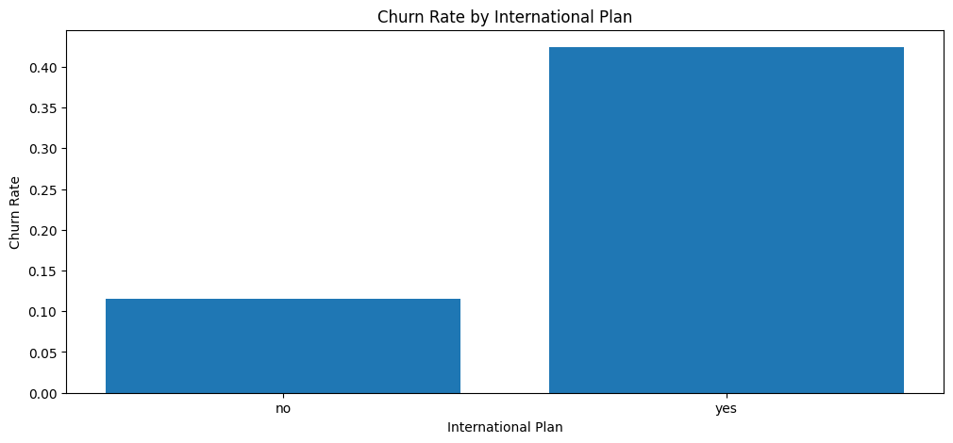
EDA output 1
Observation: Customers who have an international plan are more likely to churn compared to those who don not.

Slide 9
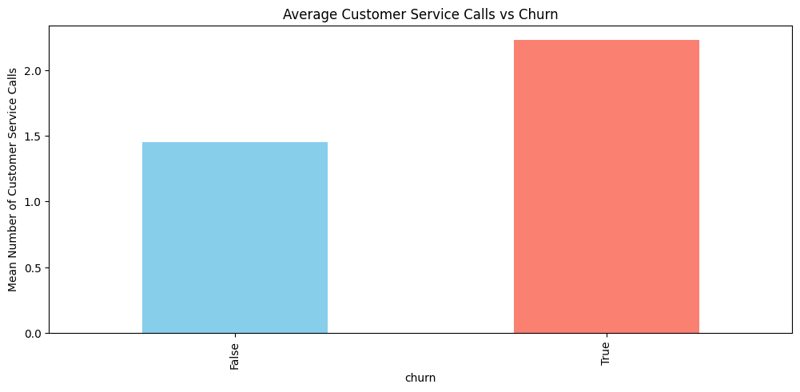
EDA output 2
Observation: Customers with a high number of customer service calls have a much higher chance of churning.

Slide 10
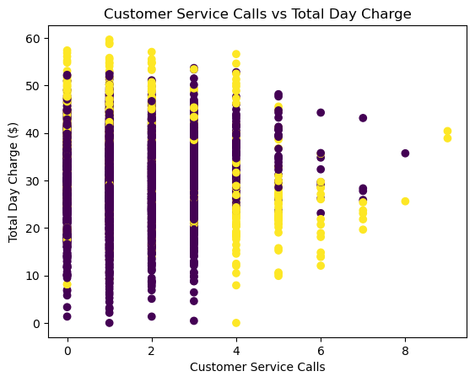
EDA output 3
Observation: Customers with higher day charges show different churn behavior, suggesting that heavy daytime users may be more sensitive to pricing.

Slide 11
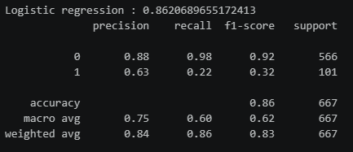
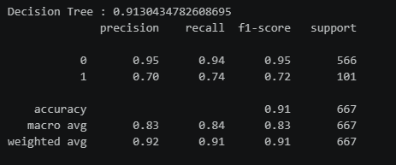
Modeling
Model 1: Logistic Regression
Model 2: Decision Tree

Slide 12
Evaluation
Logistic Regression | Decision Tree
1- Accuracy (86%) 2- For customers who will Stay (0): The model is very reliable when it says someone will stay. 3- For customers who will Churn (1): When the model predicts a customer will leave, it is correct 63% of the time (about 6 out of 10). | 1- Accuracy of 91%. 2- For customers who will Stay (class 0)- pthe precision of 95% and F-1 score of 95%. Recall was (94%) 3- For customers who will churn (class 1) - the precision is 70% and F‑1 score of 72%. Recall was 74%

Slide 13

Conclusions, Recommendations & next steps

Slide 14
Conclusion
The analysis shows that the most important factors driving churn are:
1. Number of customer service calls
2. International plan usage
3. Total day/evening charges

Slide 15
Recommendations
Based on the results from the models, the project recommends as follows:
- Improve customer service to reduce complaints
- Offer special discounts or better international rates to at-risk customers
- Target customers with high usage but low satisfaction
- Focus retention efforts on newer customers (low account length)

Slide 16
Next steps
There is need for collection of more recent data given the changes that has happened in the sector since this sample data was collected
There is need to include additional features such as complaints to the model to determine their influence on the model prediction
Consider running A/B test retention offers for predicted churners

Slide 17
Thank You
Eliud Kibet
Github: Elky-bett
LinkedIn: elkybett
Email: ekybett@gmail.com

